Slide 1
UCare Medicare Group
For PEIP Retirees and Spouses 2025

Slide 2

Our members speak for themselves
132K
96%
20+
People on Medicare trust us to provide health care coverage
Of our Medicare members stay with us year after year
Years we’ve been offering Medicare Advantage plans
UCare was the first to offer Medicare Advantage Plans in Minnesota

Slide 3

Advantages of UCare Medicare Plans
Network
We have a large statewide network including Mayo Clinic
Choice
Three plan option to fit your needs and
your budget
Customer Service
We are local — just call to talk with us
Convenience
Medical and Medicare Part D all in one plan
Lots of extras
Over-the-counter allowance, dental, vision
and hearing benefits and fitness programs

Slide 4
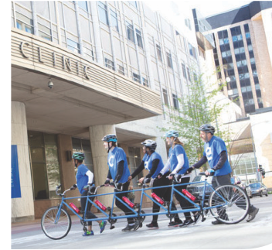
96% of all MN providers in network
Allina Health
CentraCare
Entira Family Clinics
Essentia Health
M Health Fairview
Mayo Clinic
North Memorial Health
Park Nicollet
Sanford Health
St. Luke’s
Stillwater Medical Group
University of Minnesota
Voyage Healthcare
Winona Health
and many more with no referrals needed!

Slide 5
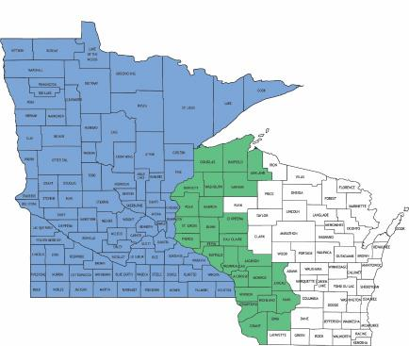
Who can join UCare Group Medicare?
Retirees and their spouses who:
  Have Medicare Part A and Part B
  Continue to pay Part B premium
  Live in Minnesota or within 26
  counties in Wisconsin

Slide 6
UCare Medicare Group Premium Rates
High
$352
Core
$177
Basic
$79
Rates are per member, per month
through 12/31/25

Slide 7

Preventive Benefits
Health Services- $0 copay
  Annual Physical
  Routine Tests
  Dental Services – 100% coverage
  3 cleanings
  2 exams
  Annual bitewing X-rays
Notes:
Almost every primary care clinic is in our network! Your chosen clinic is just a home base – your doctor does not have to approve, refer, or sign off on anything for you to see whoever you want. Yes, ALMOST every primary care clinic, the few primary care clinics of HealthPartners are not within our network, but the specialty and urgent care HealthPartners clinics are. For those that use the internet, it’s best to click Find a Doctor on UCVare.org to search for your doctor in the network. Choose UCare for Seniors as your plan.

Slide 8

Doctor Visits
Primary
  Use Find a Doctor tool
  Change clinics anytime
  Just a home base
  Primary Office Visit
  $0 copay on all plans
  $0 copay for Mental Health
Specialists
See any Specialist
  No referral needed
  Simply make an appointment
  Use Find a Doctor tool
  Specialist Office Visit
  High - $15 copay
Core - $30 copay
  Basic - $40 copay
Notes:
Almost every primary care clinic is in our network! Your chosen clinic is just a home base – your doctor does not have to approve, refer, or sign off on anything for you to see whoever you want. Yes, ALMOST every primary care clinic, the few primary care clinics of HealthPartners are not within our network, but the specialty and urgent care HealthPartners clinics are. For those that use the internet, it’s best to click Find a Doctor on UCVare.org to search for your doctor in the network. Choose UCare for Seniors as your plan.

Slide 9

Hospital and Skilled Nursing
Inpatient
Covered at 100% after copay
  High – $100 copay per admission
  Core – $125 copay per admission
  Basic – $400 copay per admission
Outpatient
High - $200 copay
Core - $250 copay
Basic - $250 copay
  Skilled Nursing Facility Care
  No three-day in-patient hospital stay requirement
  $0 for days 1 through 20
  $100 per day for days 21 through 100

Slide 10
Medical Out-of-Pocket Maximum
High
$2,800 per calendar year
Core
$3,000 per calendar year
Basic
$3,400 per calendar year
Once met, all services are covered 100% for the rest of the year

Slide 11

YES! Coverage when you travel
UCare AnywhereSM travels with you in the U.S.
Some services with same copays as in network
Coverage for other non-ER services
Out of State Providers with MultiPlanTM Network
Expanded national network of providers
Same great coverage as in network
Emergency coverage worldwide
Travel out of area up to 6 consecutive months
No need to notify us of your coming and goings

Slide 12
2025 Part D changes
As part of the inflation reduction act, Congress made several changes to the Part D program that will be implemented for the first time in 2025.
Those changes include :
Eliminating the coverage gap phase from the standard Par D benefit structure and eliminating the manufacturer coverage gap discount program
Adding a new manufacturer discount program
Capping beneficiary out-of-pocket costs at $2,000
Adding a new program (the Medicare Prescription Payment Plan) that provides beneficiaries the option to pay their out-of-pocket Part D prescription drug costs in monthly amounts

Slide 13

Are my prescription drugs covered?
Find your drugs
Search online or our formulary
5 tiers of coverage
Fill your prescriptions
60,000 pharmacies
Mail order through Costco
Get a 3-month supply for 2 copays
  Up to 100 day fills available, Tiers 1-4 (Tier 5 limited to 30-day supply)

Slide 14
 | High | Core | Basic
Deductible: You pay the full cost of your drugs until you reach this amount | $0 | Tiers 1-2 - $0 Tiers 3-5 - $200 | Tiers 1-2 - $0 Tiers 3-5 $345
Initial coverage phase: You stay in this phase until you reach the $2,000 out-of-pocket maximum. After you meet the deductible, you pay the amounts listed below.
Tier 1 - Preferred generic drugs | $0 copay | $10 copay | $10 copay
Tier 2 – Generic drugs | $5 copay | $12 copay | $12 copay
Tier 3 – Preferred brand drugs | $40 copay | $45 copay | $45 copay
Tier 4 – Non-preferred drugs | $100 copay | $100 copay | $100 copay
Tier 5 – Specialty drugs | 30% coinsurance | 25% coinsurance | 25% coinsurance
Catastrophic coverage phase: Once you have reached $2,000 in annual prescription drug spending (excluding UCare’s cost), you pay $0
*Insulin=$35 copay, no deductible

Slide 15


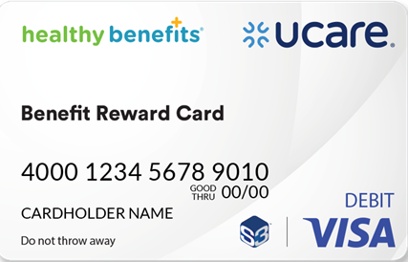

Additional Benefits – Vision and Hearing
  Vision
  Routine Vision exam – $0 copay
  Diagnostic exam - $0 to $40 copay
  $200 eyewear reimbursement
  each calendar year
  Hearing
  Routine Hearing exam – $0 copay
  Diagnostic exam - $0 to $40 copay
  Two TruHearing hearing aids per year- copay varies from $499 to $999

Slide 16
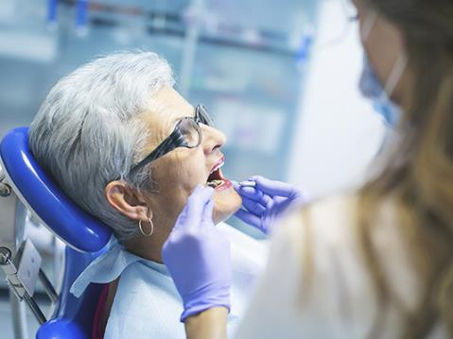
Additional Dental Benefits
Preventive dental included
  3 cleanings, 2 exams, and x-rays
Additional dental coverage for
$29 per month
  Coverage for fillings, crowns, implants
  $50 deductible
  $2500 annual maximum
*New dental carrier: DentaQuest

Slide 17


Fitness Benefits
  One Pass™ fitness program
  No cost gym membership
  23,000 locations across the country
  At home fitness kits
  More than 20,000 on-demand and live- streaming fitness classes
  Personalized online classes, at home fitness kits, personalized brain training
  Health Club Savings
  If you belong to a participating health club that is not in the One Pass network, you may receive a reimbursement of up to $30 in your monthly health club membership fees.

Slide 18
More Additional Benefits
  Over-the-Counter Benefit
  $75 bi-annually toward over the counter items.
  Purchase online or at Walmart or CVS
  Use or lose within the 1/1-6/30 and 7/1-12/31 window
  Community Education Discount
  Get $45 a year to use on most community education classes, like fitness, cooking or learning new language.

Slide 19
How to join
Contact us to have an Enrollment Kit sent to you
  Includes 2 applications and 2 plan choice forms
  Each fills out an application and plan choice form
  Mail forms in postage-paid green envelope provided
  Or
Enroll online via DocuSign
  Visit ucare.org/retirees
  Contact us to have a link sent to your email
  612-676-6900
  Groupsales@ucare.org

Slide 20
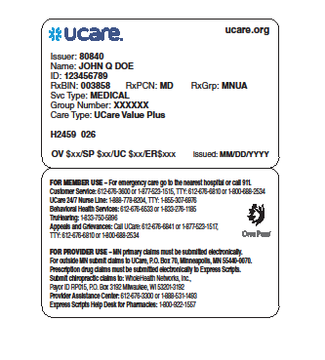
Welcome to UCare!
Confirmation of enrollment
Member ID card
Customer Service
UCare 24/7 Nurse Line
Disease Management Programs
Member Portal at ucare.org

Slide 21
Questions about UCare Medicare Group
Contact us:
Group Sales Team
  Phone: 612-676-6900
  Toll Free: 1-877-598-6574
  Email: groupsales@ucare.org

Slide 22
THANK
YOU
www.ucare.org

